Slide 1
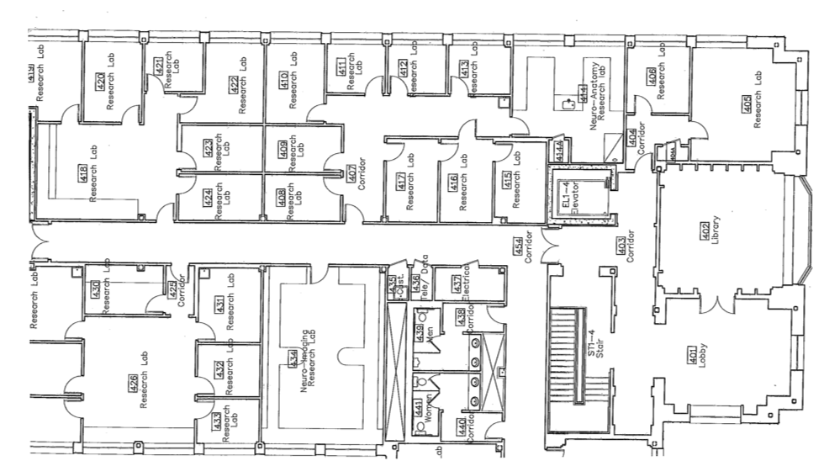
Electrical Box
Sink
Manning
4th Floor
Labs

